Slide 1
Vectors
Dr. Nelson Xess

Slide 2
Plasma Vectors
These are the most common vectors for the prokaryotic host cells. Bacteria are able to ex press foreign genes inserted into plasmids .
Plasmids are small, circular, double- stranded DNA molecules lacking protein coat that naturally exists in the cytoplasm of many strains of bacteria.
Some of the examples of naturally occurring plasmids are Ti plasmids, F-factors, R-factors, Co/E1 plasmid, etc.
Plasmids are independent of the chromosome of bacterial cell and range in size from 1000 to 200 000 base pairs. Using the enzymes and 70s ribosomes that the bacterial cell houses, DNA contained in plasmids can be replicated and expressed.

Slide 3
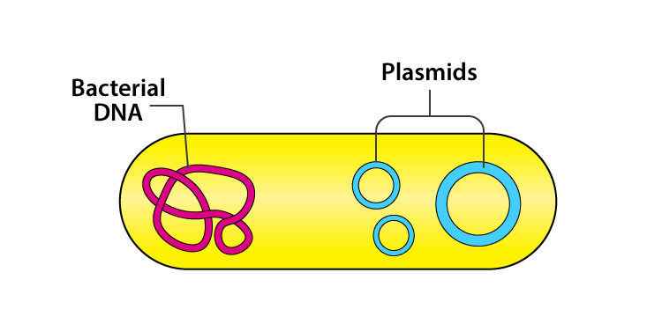

Slide 4
The bacterial cells benefit from the presence of plasmids, which often carry genes that express proteins able to confer antibiotic resistance. These also protect bacteria by carrying genes for resistance to toxic heavy metals, such as mercury, lead, or cadmium.
In addition, some bacteria carry plasmids possessing genes that enable bacteria to break down herbicides, certain industrial chemicals, or the components of petroleum. The relationship between bacteria and plasmids is endosymbiotic; both the bacteria and plasmids benefit from mutual arrangement. Plasmids also possess characteristic copy number.
The higher the copy number, higher is the number of individual plasmids in a host bacterial cell. If more copies of plasmid exist, more protein will be synthesized because of the larger number of gene copies carried by the plasmid. The num ber of copies plays a role in phenotypic manifestation of a gene. For example, the more copies of an antibiotic-resistance gene there are, the higher the resistance to the antibiotic.
It is very important to note that naturally occur ring plasmids do not have all necessary sequences which are required by a DNA molecule to act as a profitable vector. Due to this, natural plasmids are extracted and modified by inserting suitable DNA segments and a complete vector DNA molecule is made.

Slide 5
pBR322 Vectors
This was the first widely used, purpose built plasmid vector. pBR322 has a relatively small size of 4,363 bp. This is important because transformation efficiency is inversely proportional to size and above 10 kbp is very low.
Thus, there is ‘room’ in pBR322 for an insert of at least six kbp. Also this vector has a reasonably high copy number (~15 copies per cell), which can be increased 200-fold by treatment with a protein-synthesis inhibitor—chloramphenicol amplification.

Slide 6
Nomenclature of pBR 322
‘p’ indicates as a plasmid.
‘BR’ identifies Bo-liver and Rodriguez, the two researchers who developed it.
‘322’ distinguishes those plasmids from others (like pBR 325, pBR 327, etc.) developed in the same laboratory.

Slide 7
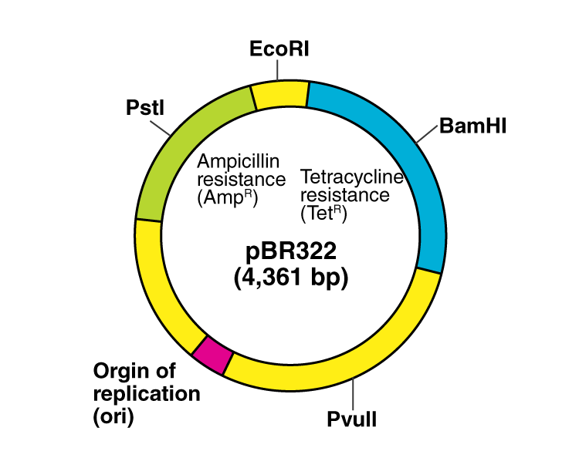
Construction of pBR322
Origin of Replication- It carries a frag ment of plasmid pMB1 that acts as an ori gin for DNA replication and thus ensures multiplication of the vector.

Slide 8
Selectable Marker- It carries two anti biotic resistance genes—ampicillin and tetracycline.
Cloning Sites- It carries a number of unique restriction sites. Some of these are located in one of the antibiotic resistance genes (e.g., sites for Pst I, Pvu I, and Sac I are found in Ampr and BamHI and Hind III in Tetr). Cloning into one of these sites inactivates the gene allowing recombinants to be differentiated from non-recombinants known as insertional inactivation.

Slide 9
Cloning a foreign DNA in to plasmid vector

Slide 10
Advantages of pBR322
Small size (~ 4.4 kb) enables easy purifi cation and manipulation.
Two selectable markers (amp and tet) al low easy selection of recombinant DNA.
. It can be amplified up to 1000-3000 copies per cell when protein synthesis is blocked by the application of chloramphenicol.

Slide 11
Disadvantages of pBR322
It has very high mobility i. e; it can move to another cell in the presence of a conjugative plasmid like F-factor. The nic-bom (bom=basis of mobility) region of pBR322 is responsible for this feature. Due to this, the vector may get lost in a population of mixed host cells.
There is a limitation in the size of the gene of interest that it can accommodate.
Not a very high copy number is present as is expected from a good vector.
Although insertional inactivation of an antibiotic resistance gene provides an ef fective means of recombinant identifica tion, the method is made inconvenient by the need to carry out two screenings, one with the antibiotic that selects for trans-formants, followed by the second screen, after replica plating, with the an tibiotic which distinguishes recombinants.

